Slide 1

FULLSTACK PROJECT(FRONT-END)
GLA CANTEEN PORTAL

Slide 2

TEAM MEMBERS
1.SANAL MISHRA
2.SARVENDRA KUMAR SINGH
3.YASH KUMAR SINGH
4.PRABHAT KUMAR SINGH
MENTOR: Mr. PANKAJ KAPOOR

Slide 3

ABOUT THE PROJECT
Our idea is to make a canteen portal named as GLA canteen portal, which will help students to book their meal earlier so that they don’t have to wait for long to get their meal. and Also they will get information about the availability of the meal they want. And also it will also be helpful for the chefs to prepare the meal and they can tell the estimated time to the students so that they could take their meal on time. This project GLA Canteen portal will manage all the details of Food, Items, Sales, Products, Canteen. It manages information about Food, Orders, Canteen, Food.

Slide 4

HARDWARE AND SOFTWARE REQUIREMENTS
Hardware Requirements:
Processor: i5 8 gen and above
Minimum of 4 Gb ram and 256 Gb rom.
Software Requirements:
VS-CODE or any web development IDe.
A Web Browser

Slide 5

GLIMPSE OF TECHONOLOGY USED:
HTML, CSS, & JavaScript
HyperText Markup Language (HTML), Cascading Style Sheets (CSS), and JavaScript are the languages that run the web. ... HTML is for adding meaning to raw content by marking it up. CSS is for formatting that marked up content. JavaScript is for making that content and formatting interactive.

Slide 6

MODULES AND FUNCTIONALITY
The HTML files that we have included in our project are:
AfterSignIn.html
beverages.html
cakes.html
confectionery.html
ice-cream.html
paranthas.html
Snacks.html

Slide 7

CONTINUED..
CSS files that we have included in our project:
AfterSignIn.css
beverages.css
Cakes.css
confectionery.css
ice-cream.css
paranthas.css
Snacks.css

Slide 8

CONTINUED..
There is only one JavaScript file that we had worked on:
Homepage.js

Slide 9
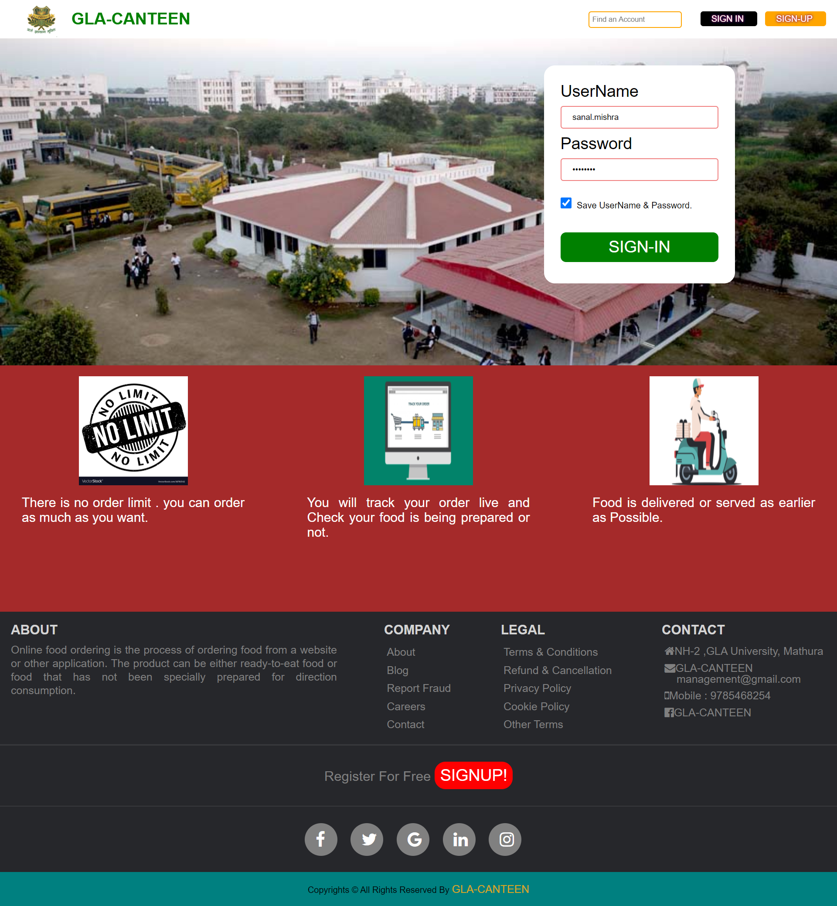
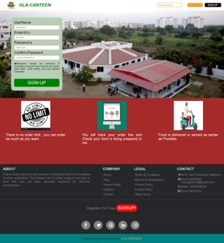
RELATED SCREENSHOTS:
This is the screenshot of the homepage.

Slide 10
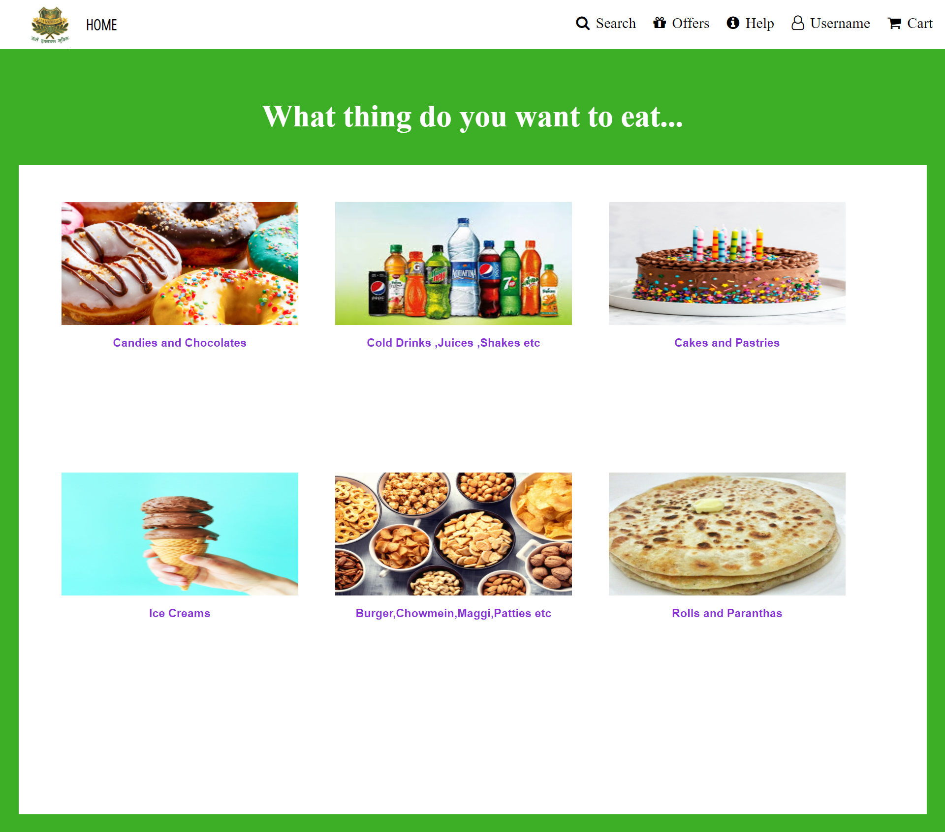
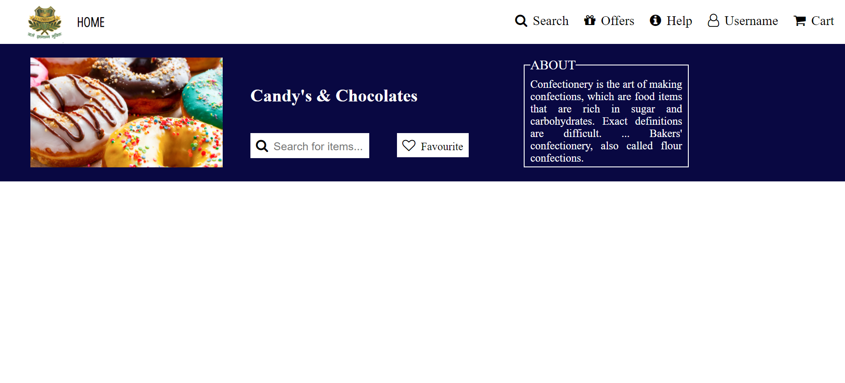
CONTINUED..
Some more screenshots.

Slide 11
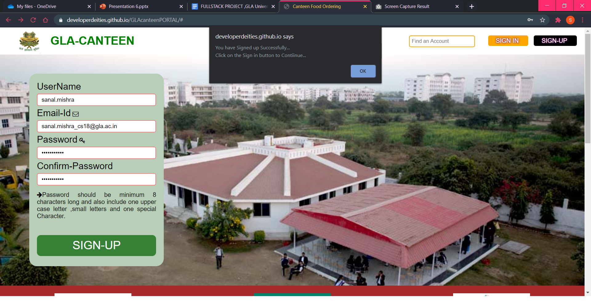
CONTINUED..

Slide 12
OUR WEBSITE IS LIVE AT:
https://developerdeities.github.io/GLAcanteenPORTAL/

Slide 13

REFRENCES
www.google.com
https://www.beta-labs.in
https://www.w3schools.com
https://stackoverflow.com
https://www.geeksforgeeks.org

Slide 14


